Slide 1
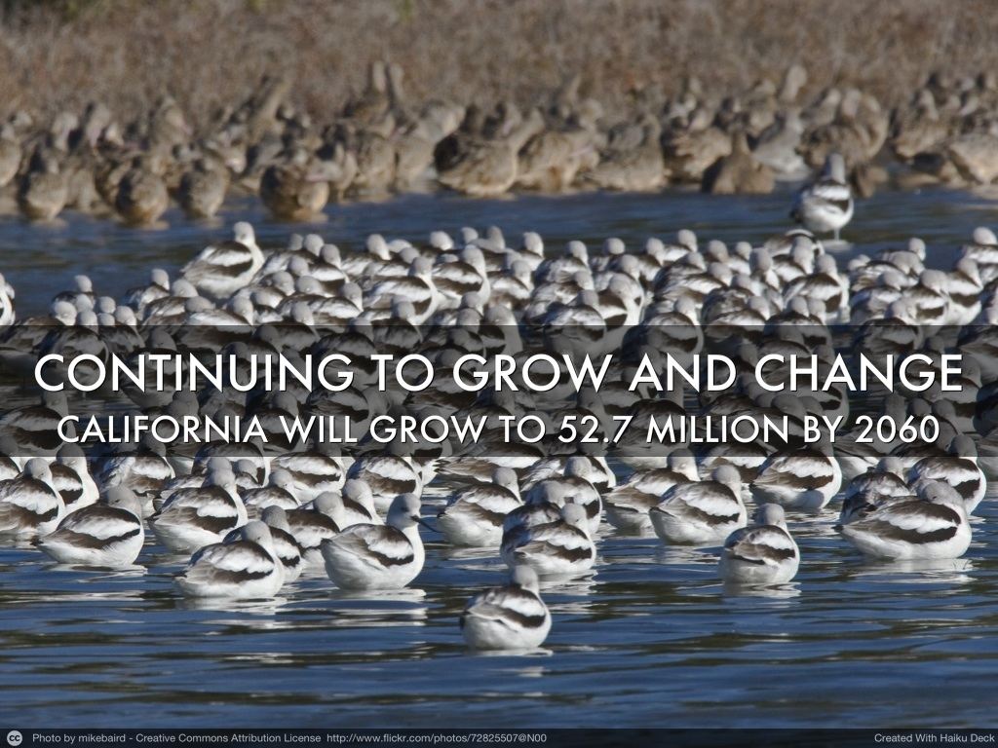
California Department of Finance, January 2013

Slide 2
We are:
Erica Padilla-Chavez, MPA, MA III
  County of Monterey Health Department, Planning, Evaluation & Policy Unit
Jesse Herrera, LCSW
  Latino Social Workers of Monterey County
  New Policies for a New Reality Conference
  September 17, 2013

Slide 3
California Department of Finance, January 2013

Slide 4
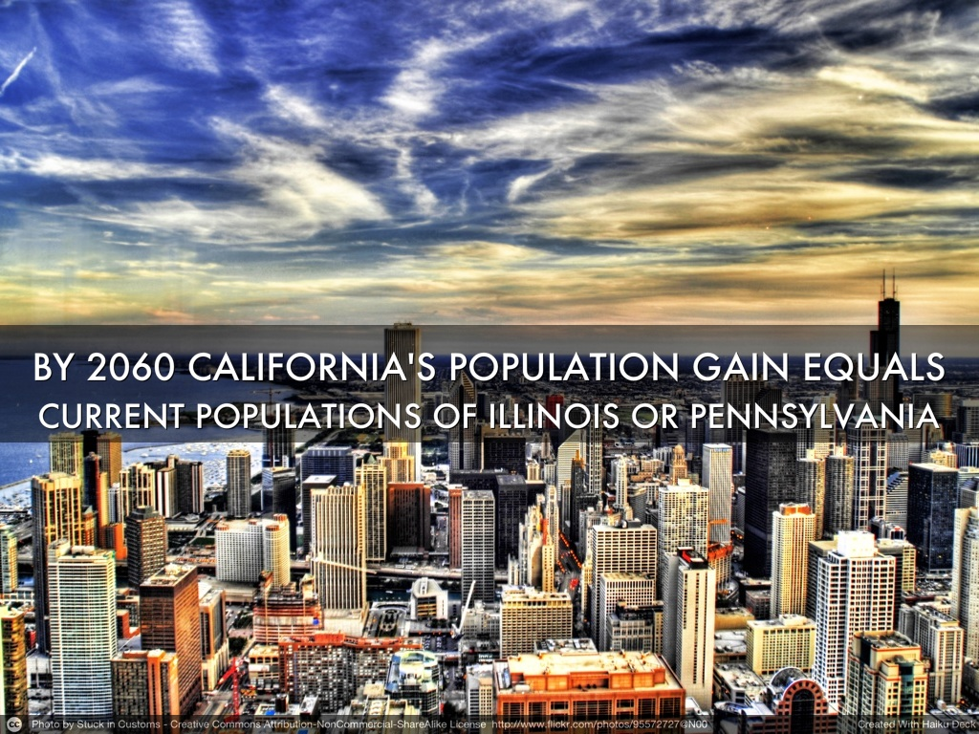
California Department of Finance, January 2013

Slide 5
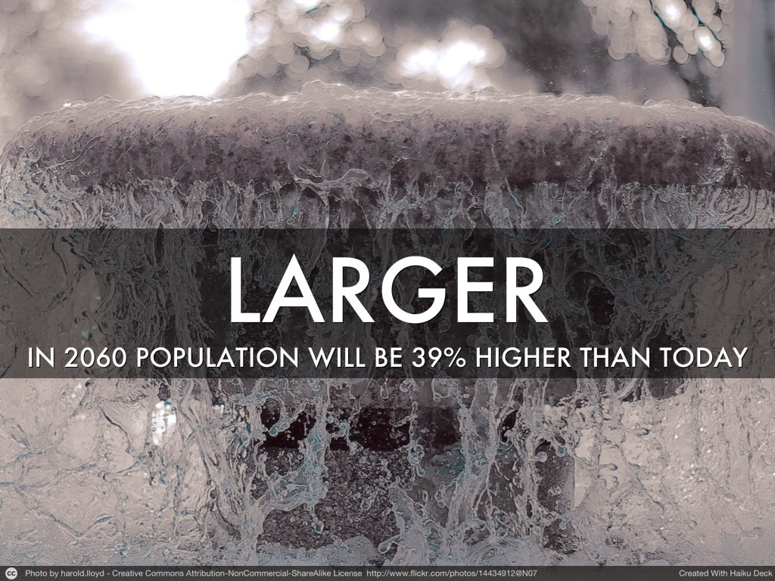
California Department of Finance, January 2013
Notes:
SACRAMENTO— California’s population will cross the 50 million mark in 2049 and grow to nearly 52.7 million by 2060, according to new population projections released today by the Department of Finance.
This population gain – nearly 15.4 million between 2010 and 2060 – would exceed the current populations of either Illinois or Pennsylvania, and would represent enough new residents to currently rank as the fifth largest state in the Union.
The 2060 population will be 39 percent higher than the state’s most recent 2012 population estimate
Plurality slide
The latest projection series indicates that the Hispanic population will be even with the number of non-Hispanic Whites by mid-2013.
Early in 2014, the Hispanic population will become the plurality in California for the first time since California became a state

Slide 6
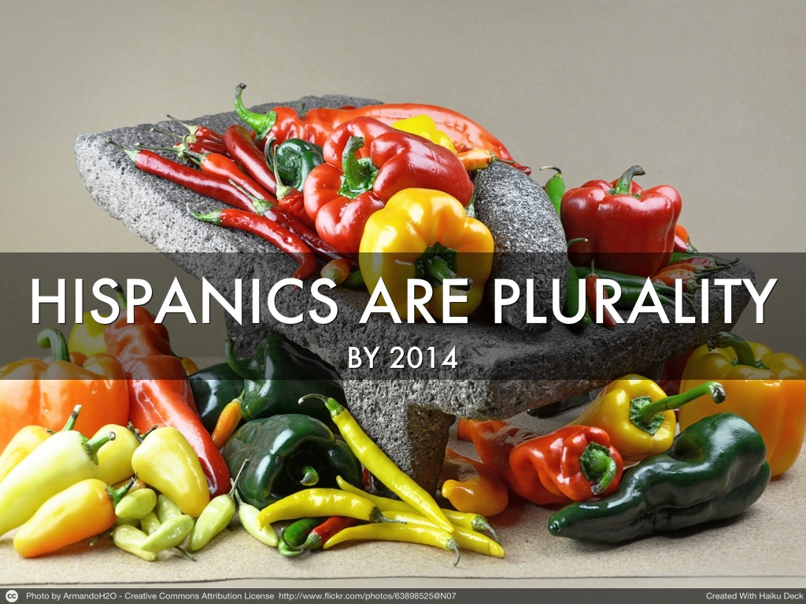
California Department of Finance, January 2013

Slide 7
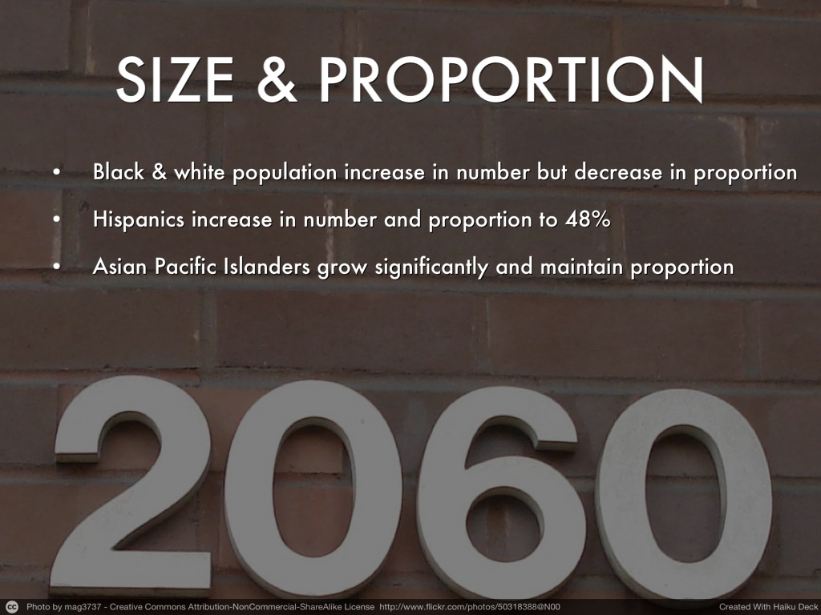
California Department of Finance, January 2013

Slide 8
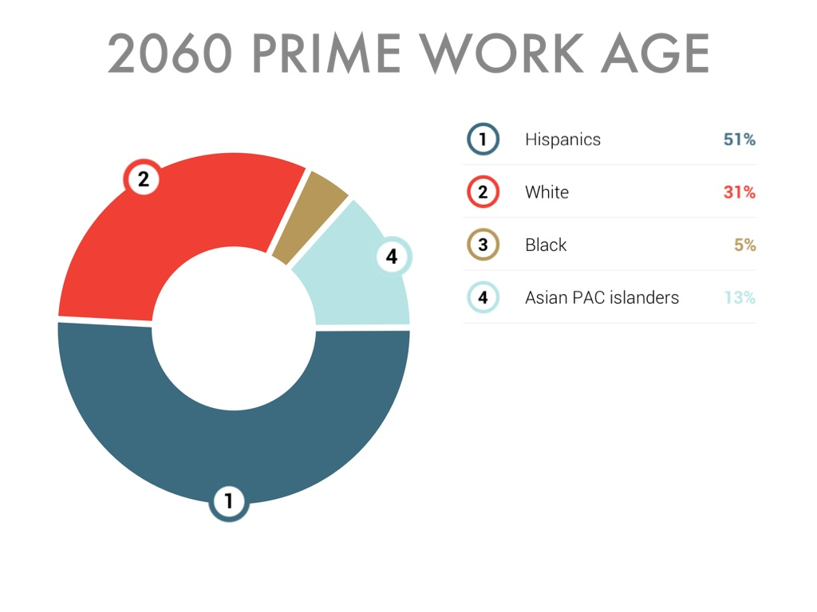
California Department of Finance, January 2013
Notes:
In 2030, there will be 9.6 million Hispanics in the prime working ages of 25 to 64; Whites will have 7.2 million and Asians 3.1 million.
By 2060, Hispanics will be the largest group in the working ages by a considerable margin: 12.1 million Hispanics to 7.4 million Whites and 3.2 million Asians

Slide 9
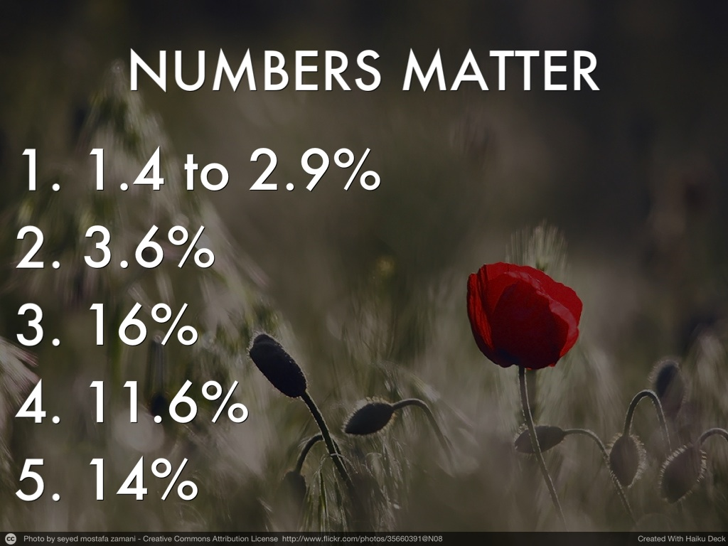
Notes:
August 16, 2013 Labor Market Information Division
March 2012 Benchmark http://www.labormarketinfo.edd.ca.gov
(916) 262-2162
Monthly Labor Force Data for Cities and Census Designated Places (CDP)
July 2013 - Preliminary
Data Not Seasonally Adjusted
EDD Census Ratios
Area Name Unemp
Monterey County 8.2%
Aromas CDP (Monterey Co) 3.4%
Boronda CDP 9.2%
Bradley CDP 0.0%
Carmel by the Sea city 1.4%
Carmel Valley Village CDP 2.9%
Castroville CDP 15.9%
Chualar CDP 22.0%
Del Monte Forest CDP 2.1%
Del Rey Oaks city 2.0%
Elkhorn CDP 4.5%
Gonzales city 16.0%
Greenfield city 13.0%
King City city 14.0%
Las Lomas CDP 18.1%
Marina city 4.8%
Monterey city 3.6%
Moss Landing CDP 18.6%
Pacific Grove city 3.0%
Pajaro CDP 8.1%
Prunedale CDP 5.9%
Salinas city 11.6%
San Ardo CDP 19.3%
San Lucas CDP 17.1%
Sand City city 0.0%
Seaside city 4.7%
Soledad city 10.5%
Spreckels CDP 0.0%

Slide 10
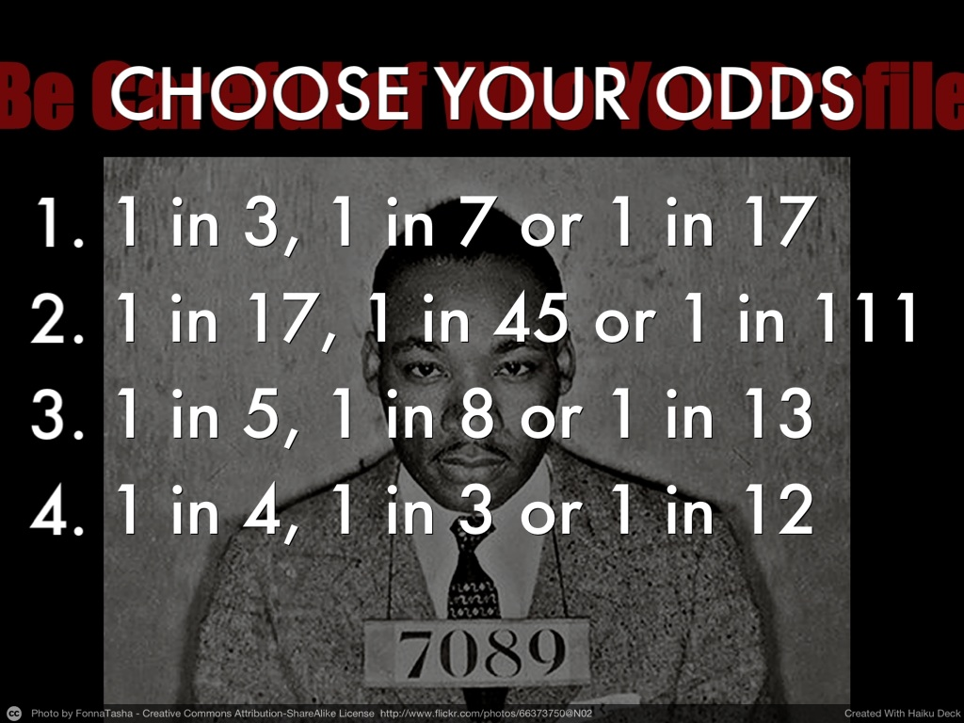
Notes:
Bullet instead of numbers (infers ranking and you want audience to rank what they would like). Remember to cite verbally after point has been made:
Chance of boys born in 2001 going to prison: African –American, Latino and White respectively
Chance of girls born in 2001 going to prison: African –American, Latino and White respectively
Chances of Latino Children, African –American Children and White Children without Health Insurance
I Can’t find this Stat
Cradle to Prison Report, Children’s Defense Fund, 2009
Excerpt from America's Cradle to Prison Report
http://www.childrensdefense.org/child-research-data-publications/data/cradle-prison-pipeline-report-2007-full-highres.html
Item 1&2
A Black boy born in 2001 has a 1 in 3 chance of going to prison in his lifetime; a Latino boy a 1 in 6 chance; and a White boy a 1 in 17 chance.
A Black girl born in 2001 has a 1 in 17 chance of going to prison in her lifetime; a Latino girl a 1 in 45 chance; and a White girl a 1 in 111 chance.
Item 3
Inadequate Access to Health Coverage – One out of five Latino children and one out of eight Black children are uninsured, compared to one out of 13 White children
Item 4
Pervasive Poverty – Poverty is the largest driving force behind the Pipeline crisis, exacerbated by race. Black children are more than three times as likely as White children to be born into poverty and to be poor, and are four times as likely to live in extreme poverty. One in 3 Latino babies and 3 in 7 Black babies are born into poverty. More than 1 in 4 Latino children and 1 in 3 Black children are poor. Between 2000 and 2007, the number of poor Latino children increased by 960,000 (to 4.5 million) and the number of poor Black children increased by 323,000 (to 3.9 million).

Slide 11
California Department of Finance, January 2013
Notes:
make all of the age groups the same color through out this series of slides; easier for the viewer to follow. Some slides have shadowing and some don’t. Make all one way or the other.

Slide 12
California Department of Finance, January 2013
Notes:
make all of the age groups the same color through out this series of slides; easier for the viewer to follow. Some slides have shadowing and some don’t. Make all one way or the other.

Slide 13
California Department of Finance, January 2013
Notes:
make all of the age groups the same color through out this series of slides; easier for the viewer to follow. Some slides have shadowing and some don’t. Make all one way or the other.

Slide 14
California Department of Finance, January 2013
Notes:
make all of the age groups the same color through out this series of slides; easier for the viewer to follow. Some slides have shadowing and some don’t. Make all one way or the other.

Slide 15
California Department of Finance, January 2013
Notes:
make all of the age groups the same color through out this series of slides; easier for the viewer to follow. Some slides have shadowing and some don’t. Make all one way or the other.

Slide 16
California Department of Finance, January 2013
Notes:
make all of the age groups the same color through out this series of slides; easier for the viewer to follow. Some slides have shadowing and some don’t. Make all one way or the other.

Slide 17
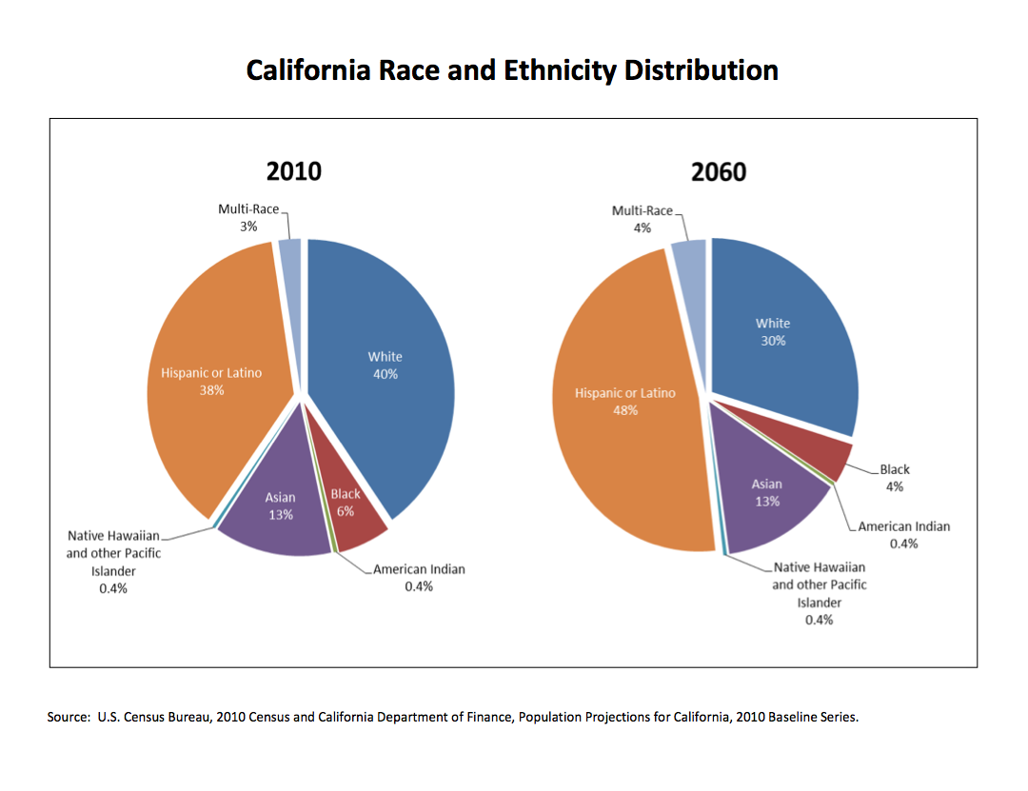
California Department of Finance, January 2013
Notes:
Cite source on slide.

Slide 18
California Department of Finance, January 2013

Slide 19
California Department of Finance, January 2013

Slide 20
California Department of Finance, January 2013

Slide 21
California Department of Finance, January 2013

Slide 22
California Department of Finance, January 2013

Slide 23
California Department of Finance, January 2013
Notes:
Cite source on slide.

Slide 24


Slide 25


Monterey County Health Department
We are committed to building opportunities for dialogue & learning to achieve Health Equity
Notes:
At the HD, we understand changing times require change in thought not just because of the data, but perhaps more importantly because we heard it loud and clear from residents.
We know that good health is not shared equally by all. The residents we spoke with through the development of the HD Strat Plan understand this. They recognized that health sits outside of the walls of the health department, they understand that health is everywhere.
In order to move

Slide 26
Community’s Voice
What do you need to be healthy?
Safe Streets
Opportunity for good paying jobs
Quality Education
Safe parks and open space to recreate (soccer fields with lights)
Schools as hubs of information of all community issues
Notes:
Here’s an example of what I mean when I say this:
-explain the issues community raised when we asked them what they needed to be healthy.
-Highlight a few of the points
-Summary, the community understands that health goes beyond that of physical health-they understand the relationship that health has to the social, environmental and economic opportunities made available to them.
-These opportunities or lack thereof then act as determinants of health and it is here where our work should reside.

Slide 27
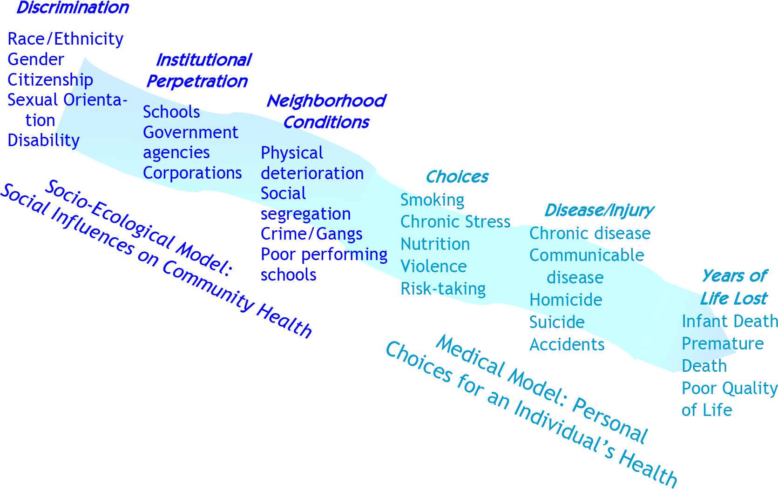

HEALTH EQUITY FRAMEWORK
Monterey County Health Department Strategic Plan, 2011
Notes:
Explain that in order for us to move toward addressing community concerns, we needed to work outside of the medical model and embrace the socio-ecological model that addresses the social factors that impact a persons health and wellbeing. This is the health equity framework (explain the upstream approach)

Slide 28
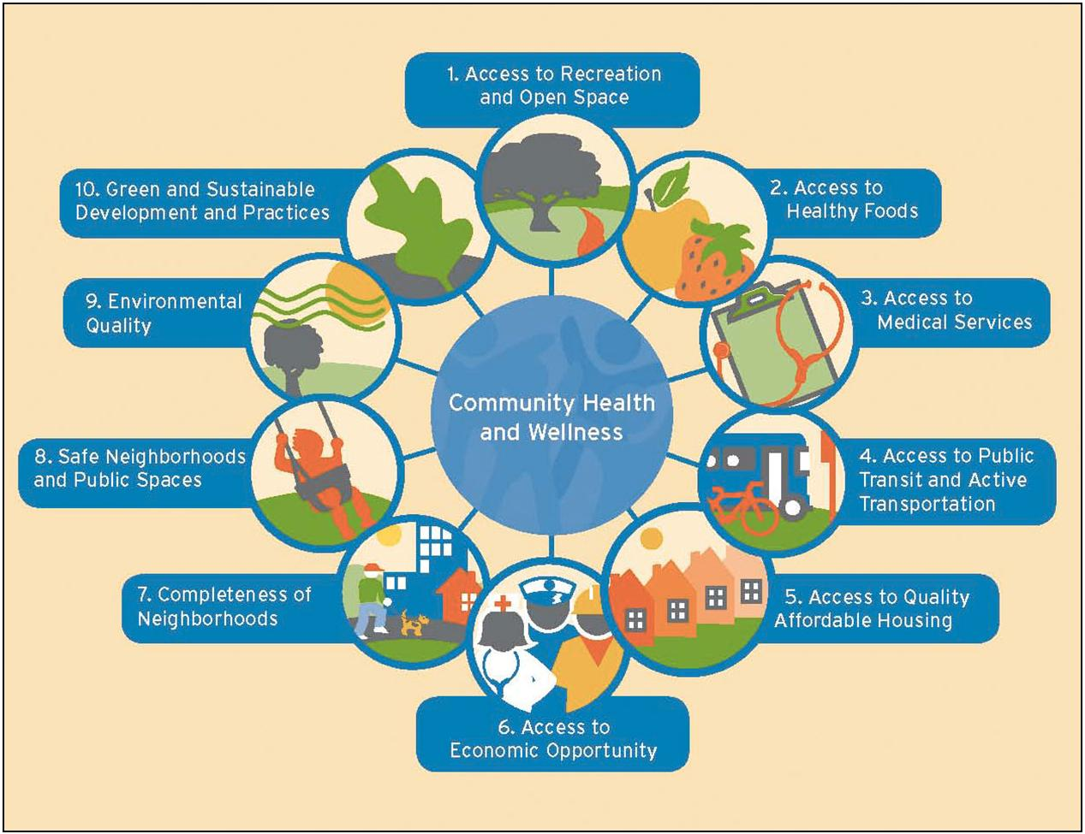
HEALTH IN ALL POLICES/HEALTH IN ALL PLACES
Notes:
To mechanize this framework, a strategy known as HiAP (or Health in all places) brings together a multi-sectoral group to address health and wellness. The goal of this collaborative is to identify policy issues of common interest in order to address and improve the social determinants of health. Another way to think about the role that social determinants is by associated the determinants to that of roots in a tree. (next slide)

Slide 29
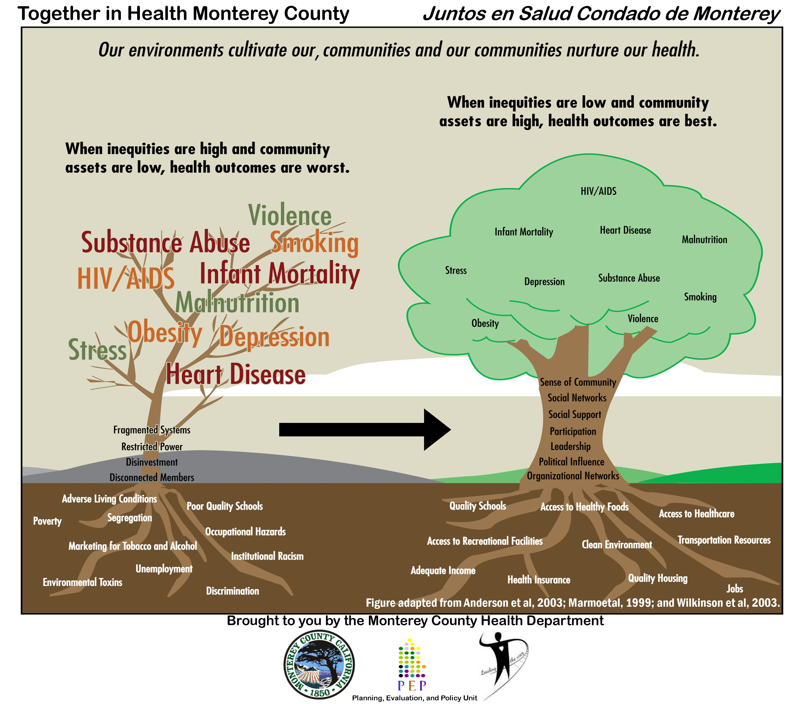
Notes:
Explain the diagram.
Invite folks to participate in the educational opportunities we are offering throughout the next few months (emails sent out as Together in Health Monterey County).
Turn it back to Jesse

Slide 30


Slide 31


Slide 32


Slide 33


Slide 34
Data Resources
Slide 2 - 7 and 10-22 California State Department of Finance Demographic Research Unit - State and County Population Projections by Race/Ethnicity, Age, and Gender, 2010-2060 January 31, 2013 http://www.dof.ca.gov/research/demographic/
Slide 8 California Employment Development Department Labor Market Information Division http://www.labormarketinfo.edd.ca.gov
Slide 9 Children’s Defense Fund America's Cradle to Prison Pipeline Report http://www.childrensdefense.org/child-research-data-publications/data/cradle-prison-pipeline-report-2007-full-highres.html

